Slide 1
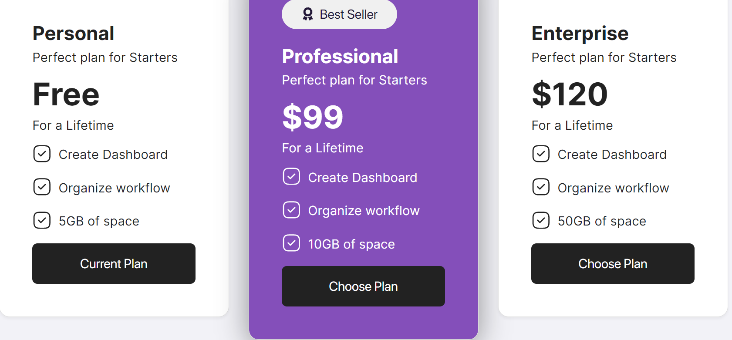
Strategy / Vision
Solution
Leadership
When user pays this membership, he gets access to the next pages material information

Slide 2





I
Strategy/Vision
II
Solution
III
Leadership
When user has bought the membership « Strategy/vision », he gets access to its 8 themes. (see the 8 themes of Strategy/vision on the next slide)

Slide 3
Strategy / Vision
Deliverable | Description | Question Answered
#1. Starting Vision | Identify a unified Metaverse definition Define the vision and guiding principles for the enterprise’s Metaverse strategy Align on provocations to drive future-state business model framework Define success metrics Re-prioritize current POC & Year 1 roadmap Identify critical milestones for Year 1 Define Metaverse governance and support model Identify present existing capabilities or known capability gaps | How does the enterprise define the Metaverse? What is our overarching vision for the MV? What are our guiding principles / commandments for the MV to drive decision-making and prioritization going forward? …. …. ….
#2. Ongoing Research Pod
#3. Enterprise Metaverse Strategy
#4. Metaverse Measurement/KPI Strategy
#5. Future Experience and Audience Strategy
#6 GTM Strategy & Assessment
#7. 3/5/10-year Roadmap incl Proof-of-strategy plan
#8. Metaverse Business Case
This is just to show you that “Straregy/Vision” has 8 themes. And in each theme, there are some descriptive-Questions to guide the user towards understanding the Theme. So, it's not a screen to design, it's just a support to help you design the next screens.

Slide 4






I.
# 1. Starting Vision
# 2. Ongoing Research
# 3.Enterprise Metaverse Strategy
If user clicks on the theme of his choice, he will see the questions attached to that. They will be at maximum 10-11 questions per theme to be answered
8 Interview Questions
9 Interview Questions
8 Interview Questions
# 4. Metaverse Measurement/KPI Strategy
#5. Future Experience and Audience Strategy
#6 GTM Strategy & Assessment
Each square theme represents one web page. But the thing is the design is the same for all which is easy to repeat once we will did one.
5 Interview Questions
10 Interview Questions
7 Interview Questions

Slide 5

1. Starting Vision
Let’s star by give you a great vision about the Metaverse align to your context
Let’s star by give you a great vision about the Metaverse
Outcomes/Why and Metaverse Roles will be Zones texts that i will fill by myself for each question related. Tips button will open a pop-up in the screen same as « button video ».
Let’s say the user has selected the first theme on the previous slide (screen).
Identify a unified Metaverse definition
Define the vision and guiding principles for the enterprise’s Metaverse strategy
Align on provocations to drive future-state business model framework
Define success metrics
Re-prioritize current POC & Year 1 roadmap
Identify critical milestones for Year 1
Define Metaverse governance and support model
Identify present existing capabilities or known capability gaps
How does the enterprise define the Metaverse?
This is the question to be answered corresponding to the description.
This is the description. Each time i click on the description (here at the left), i will see the matching Question to be answered (appeared at the right)
Outcomes
Why
Metaverse Roles(Time)
To set the foundation of our future
To have a clear vision on what we want to build
Strat Manager (80%)
The idea of this screen is to give and guide the user to be able to reply or have Tips(Video, capabilities,etc..) to the Description-Question related.
Tips
MV Strat Consultant
Metaverse Strat SM (60%)

Slide 6
We will do the same thing with.. Same way to display information.. Therefore same code to duplicate.
II
Solution
III
Leadership

